Slide 1
Ensuring our school is bushfire ready
Bushfire Preparedness ~ Lal Lal Primary School

Slide 2
Presentation Overview
    Forecasts and general bushfire information
    Our fire risk and actions
    How our school has prepared for the fire season
    What can you do to prepare
    Frequently asked questions
    Where to find more information

Slide 3
Forecasts and general bushfire information

Slide 4
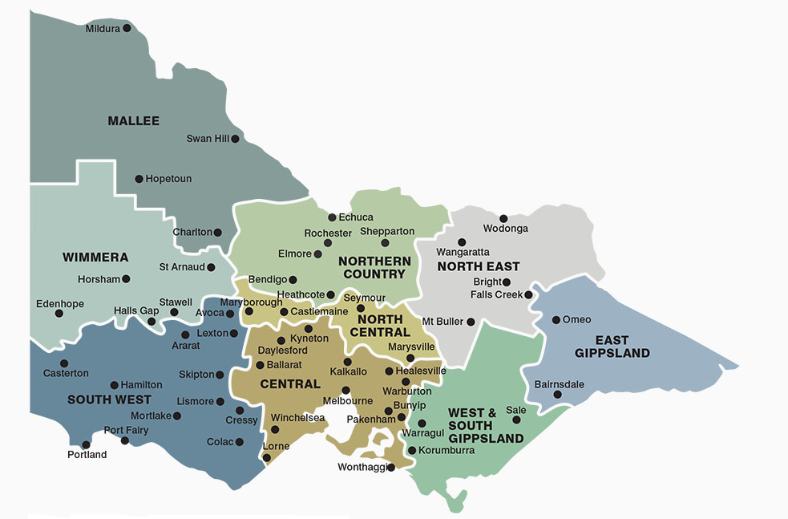
Understanding fire danger forecasts
Fire danger ratings (FDRs) provide information about the potential level of danger should a bushfire start.
FDRs are calculated by the Bureau of Meteorology (BoM) using a combination of weather forecasting and information about vegetation in the landscape that could fuel a fire.
Victoria has 9 fire weather districts, which are based on municipal council boundaries. Our school is in the South West fire weather district.
The BoM will publish the fire danger rating 4-day forecast on their website during the fire season, but these forecasts are subject to change.

Slide 5
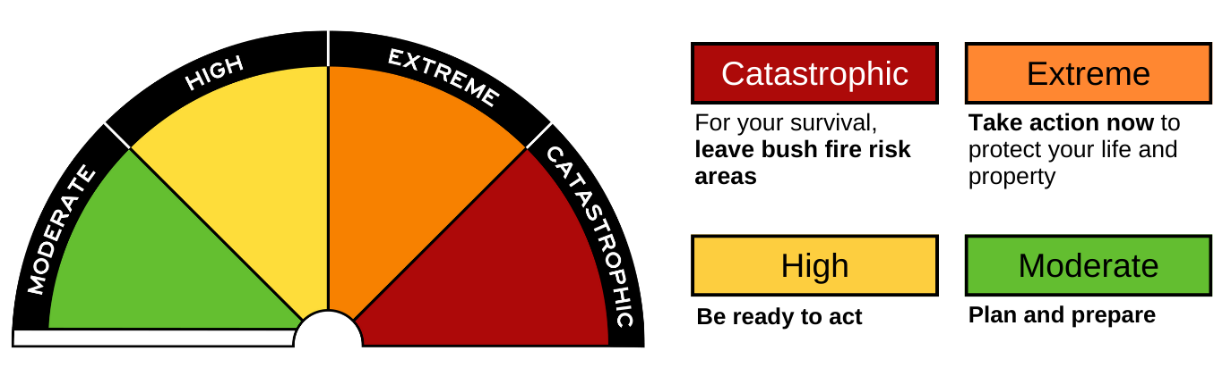
Understanding fire risk and fire danger ratings
The ratings provide information so that people can take action to protect themselves and others from the potentially dangerous impacts of bushfires.
It is important, especially during the fire season, to stay up to date with conditions, monitor your surroundings and tune in to official sources for warnings.
Since the 2022-23 fire season, Victoria uses the Australian Fire Danger Rating System which has 4 ratings; Moderate, High, Extreme and Catastrophic.
On No Rating days, no action is required because the risk of a dangerous fire is very low.

Slide 6
The Bushfire At-Risk Register and Category 4
The Department of Education worked with the CSIRO to develop the Victorian Education Facilities Fire Risk Methodology, which is used to assess the fire risk of all early childhood and school education facilities each year.
The Bushfire At-Risk Register (BARR)
        The schools and facilities in Categories 0-3 are at the highest risk of being impacted by fire in the landscape and are included on the BARR. The BARR functions as a triaged risk register to support preparation for, and response to, the annual fire season.
Category 4
        Schools and facilities that are at some risk of fire pre-emptively close in response to days of Catastrophic fire risk. These sites are at a lower level of risk than those on the BARR.
Our school is a Category 2 school.

Slide 7
Lal Lal Primary School’s fire risk and actions

Slide 8
Our fire risk and actions
    Our school is a Category 2 School.
    We will enact our pre-emptive action plan to relocate to Bunningyong Primary School on days forecast as an Extreme fire danger rating in our local government area, South West
    We will close on a day forecast as a Catastrophic fire danger rating in the South West fire district.
    All school bus routes that travel through a Catastrophic fire district will be cancelled.

Slide 9
Enacting our pre-emptive actions
    Based on the department’s Bushfire and Grassfire Preparedness Policy our school will enact our pre-emptive action plan on days forecast as an Extreme fire danger rating in our local government area, South West
    Conditions can vary significantly across the wider weather district, so using local forecasts helps us to respond appropriately to risks in our local area and maintain stability and educational continuity for our students and school community. This policy is consistent for all schools at high levels of risk and this approach is supported by emergency services.

Slide 10
How will you be advised?
    If our school needs to [enact our pre-emptive action plan to relocate, learn from home (for Category 0-2)] and/or close on a Catastrophic fire danger day (for Category 0-4), we will advise you by Compass notifications and Phone Calls.
    We will also communicate via Compass.
    We will try to provide you with advance notice of possible Extreme and/or Catastrophic days when we can. Please be aware that the forecast will not be confirmed until closer to the day.

Slide 11
Responding to the advice
    Our families play an important role in enacting our bushfire plans.
    Monitor your communications during the fire season to stay up to date. Follow the instructions provided by the school in these communications.
    Closure of the school due to a Catastrophic fire danger rating will be enacted when the BOM forecast and related public safety messaging are confirmed. Due to uncertainties in the forecast, the timing of this confirmation may vary.
    Find out more - information on school closure and school bus service cancellations, including advice on re-opening is available from the department's website.

Slide 12
Fire in the landscape
The school has an Emergency Management Plan. This plan accounts for a range of incidents including fires. If there is a fire in the landscape, we will initiate that plan, and seek advice from emergency services for the safest actions for the school.
If our Emergency Management Plan is activated, we let you know by Compass notification and Phone Call.
The Department of Education supports us to monitor warnings and weather conditions, and will work with emergency services to provide us with advice to keep our school safe.
We may ask for you to collect your children. In other circumstances, we may ask that you do not collect your children, as this may place you and them in greater danger.
All decisions will prioritise the safety of our students and will be informed by advice by the emergency services.

Slide 13
Preparing for the fire season

Slide 14
What can you do to prepare
Make sure you understand the fire danger for our area.
Review and update your family’s bushfire survival plan, including how your child will be cared for when the school or childcare service is closed due to threat of fire. Your child should not be left unattended.
Check that we have your current contact details, including mobile phone number.
Keep in touch with us by reading our newsletters, checking our website, talking to your child’s teacher and to others in our school community.
Understand our Emergency Management Plan and your role in keeping the school, its students and staff safe.
Talk to your child about bushfires and your family’s bushfire survival plan.
Talk to us including our principal, teachers or school council representatives
if you have any concerns.

Slide 15
Make a bushfire plan
The Country Fire Authority (CFA) provides great resources to support you and your family to plan ahead for the fire season.
Remember that you don’t have to live in the country to be at risk of fire.
As a member of our school community, we recommend thinking about how you will plan ahead for the fire season.
Taking steps to get prepared before the fire season means you know what to do when you’re at risk of fire.
Visit Your Bushfire Plan to use the CFA’s resources at: https://www.cfa.vic.gov.au/plan-prepare/before-and-during-a-fire/your-bushfire-plan

Slide 16
Frequently asked questions

Slide 17
Frequently asked questions
If I’m concerned about the risk of fires, can I keep my child away from school, even if the school remains open?
Yes. If your family decides to enact its bushfire survival plan, the most appropriate place for your child may be with you and your family, and not at school.
Talk to us about your family’s bushfire plan ahead of the fire season. You should also advise the school as soon as possible of your child’s absence if your plan is enacted.
When will we be informed about Catastrophic fire danger day closures?
Fire danger forecasts are issued twice daily and can change with updated information. For the safety of our school community, the decision to enact our plan will depend on the latest BOM forecast and public messaging from the emergency sector.
We will confirm the decision as soon in advance as possible. Schools will also be provided with heads-up notices if it looks like a Catastrophic rating is possible.
Notes:
The Australian Fire Danger Rating System (AFDRS) was introduced in 2022.
It is a nationally consistent system.
Victoria now uses Catastrophic fire danger as the highest fire danger rating, which indicates the worst conditions for bushfires.
This replaces Code Red, which used to be a decision or declaration by the Emergency Management Commissioner.
Fire danger ratings (including Catastrophic) are forecasts, and thus are sensitive to changes in the weather (heat, wind, relative humidity, etc). For Catastrophic, it means there is more uncertainty and variability of when this will occur compared to the old system.
The Department of Education engages closely with emergency services and the Bureau of Meteorology and will provide advice to schools at the earliest opportunities.

Slide 18
Frequently asked questions
When the school is closed, will any staff remain on-site?
No. The safety of staff and students is our main priority, and no staff will remain on-site, and all other visitors and contractors will also not be allowed on site.
Is it possible that schools will be closed for consecutive days?
If yes, how will parents be advised?
It is possible that our school will be closed for consecutive days. If this occurs, keep up to date via our communications.
We will be closed on all forecast Catastrophic days.
In addition to our communications, you can also check the Department’s website for updates.

Slide 19
Frequently asked questions
What do we do when our LGA has a different fire danger rating to the wider fire weather district?
As we respond to local conditions, there may be days during the fire season when our fire weather district, South West is forecast as an Extreme fire danger rating, but our LGA is at a lower level of fire danger. On these days our school operations will continue as normal, however we will be taking action in line with fire services advice by:
checking our Emergency Management Plan and taking any necessary preparedness actions
actively monitor our local conditions and warnings
having plans and procedures in place for if a fire starts to support us to take immediate action.
We encourage our school community to consider their own bushfire survival plan and reassess any travel through bushfire risk areas. We encourage you to follow your family bushfire survival plan and the advice of emergency services.
There may also be days where our LGA is forecast as Extreme fire danger, but South West is not. On these days we will enact our pre-emptive action plan.
Notes:
As needed: The Bureau of Meteorology produces LGA forecasts as a subset of the weather district ratings. While not issued publicly, these forecasts provided to emergency services and government departments (including the Department of Education) to support planning and operational activities.

Slide 20
Where to find more information

Slide 21
Further information
The Department of Education:
The department’s Bushfire and Grassfire Preparedness Policy guides our activities.
It is available online at: Bushfire and Grassfire Preparedness: Policy | education.vic.gov.au
Country Fire Authority (CFA):
    Plan & Prepare | CFA (Country Fire Authority)
    Your Guide to Survival | CFA (Country Fire Authority)
    Fire Ready Kit | CFA (Country Fire Authority)
Other sources:
VicEmergency is a great source for information, advice and warnings. You can access it via:
      The VicEmergency app – that can be downloaded on your android and iOS mobile devices
      Website - https://emergency.vic.gov.au
      VicEmergency Hotline -1800 226 226
      Facebook - https://www.facebook.com/vicemergency
      Twitter - https://twitter.com/vicemergency
    Tune into your emergency broadcasters such as the ABC local radio, Sky News and others.

Slide 22
Thank you for attending our bushfire preparedness presentation.

Slide 23

© State of Victoria (Department of Education) 2023
Ensuring our school is bushfire ready is provided under a Creative Commons Attribution 4.0 International licence. You are free to re-use the work under that licence, on the condition that you credit the State of Victoria (Department of Education), indicate if changes were made and comply with the other licence terms, see: https://creativecommons.org/licenses/by/4.0/
The licence does not apply to:
• any images, photographs, trademarks or branding, including the Victorian Government logo and the DE logo; and
• content supplied by third parties.
Copyright queries may be directed to copyright@education.vic.gov.au

